Slide 1



Enterprise Programming (303105309)

Slide 2
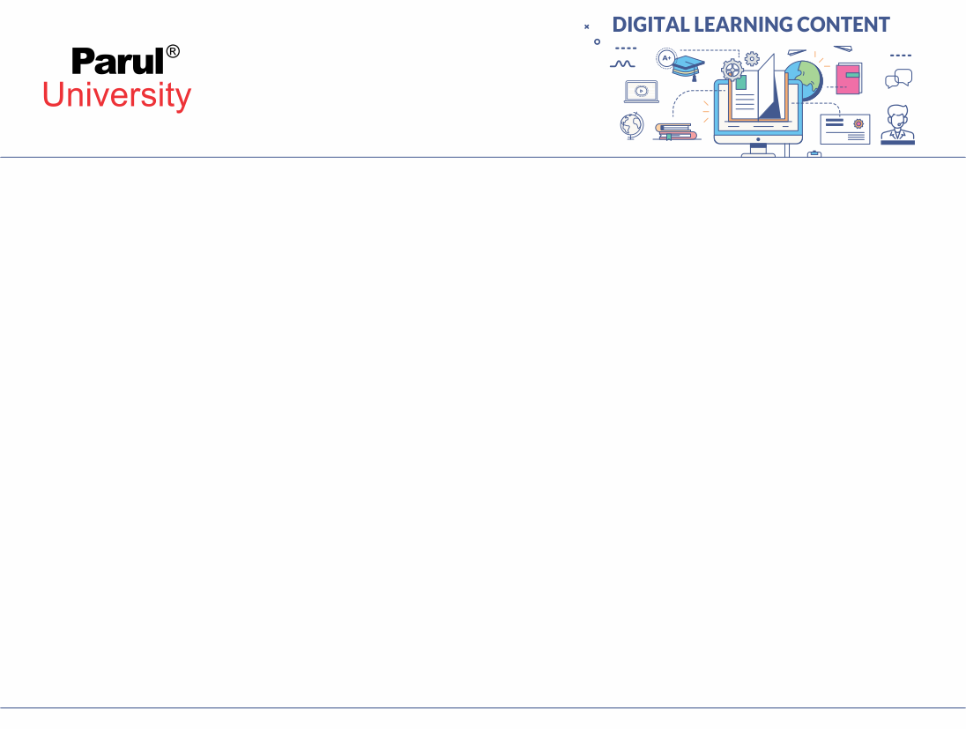

CHAPTER-4
Hibernate

Slide 3
Introduction to Servlets
Hibernate is an open-source Object Relational Mapping (ORM) framework for Java. It simplifies database connection by mapping Java classes (objects) to database tables and Java data types to SQL data types. Instead of writing long SQL queries, developers can use Hibernate APIs or HQL (Hibernate Query Language) to perform CRUD operations.

Slide 4
Why Use Hibernate?
When working with JDBC, several challenges often arise:
Database Portability Issues: Changing the database in the middle of a project is costly because JDBC code is not portable across different database systems.
Mandatory Exception Handling: JDBC requires explicit handling of exceptions for every database operation, which increases code complexity.
Lack of Object-Level Relationships: JDBC works at the table level, so there is no direct support for managing object relationships.
Boilerplate Code: For every project, repetitive code is needed for tasks like establishing connections, executing queries and handling results. This increases code length and reduces readability.

Slide 5
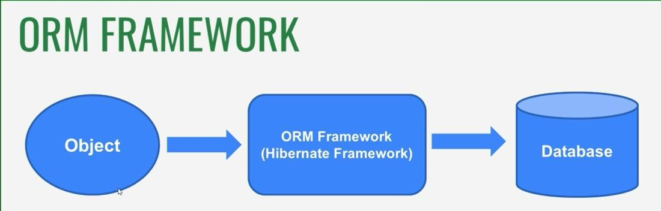
Hibernate Architecture

Slide 6
Key Features of Hibernate
Servlet
ORM (Object-Relational Mapping): Maps Java classes to database tables and Java objects to rows, enabling object-oriented database interaction.
Database Independence: Hibernate applications can run on multiple databases with minimal changes, providing portability.
HQL (Hibernate Query Language): Supports database-independent, object-oriented queries for fetching and manipulating data.
Transaction Management: Integrates with JDBC or JTA to provide reliable and consistent transaction handling.
Caching: Improves performance with first-level (session) and optional second-level caching across sessions.
Relationship Mapping: Supports mapping of object relationships like one-to-one, one-to-many, many-to-one and many-to-many.

Slide 7
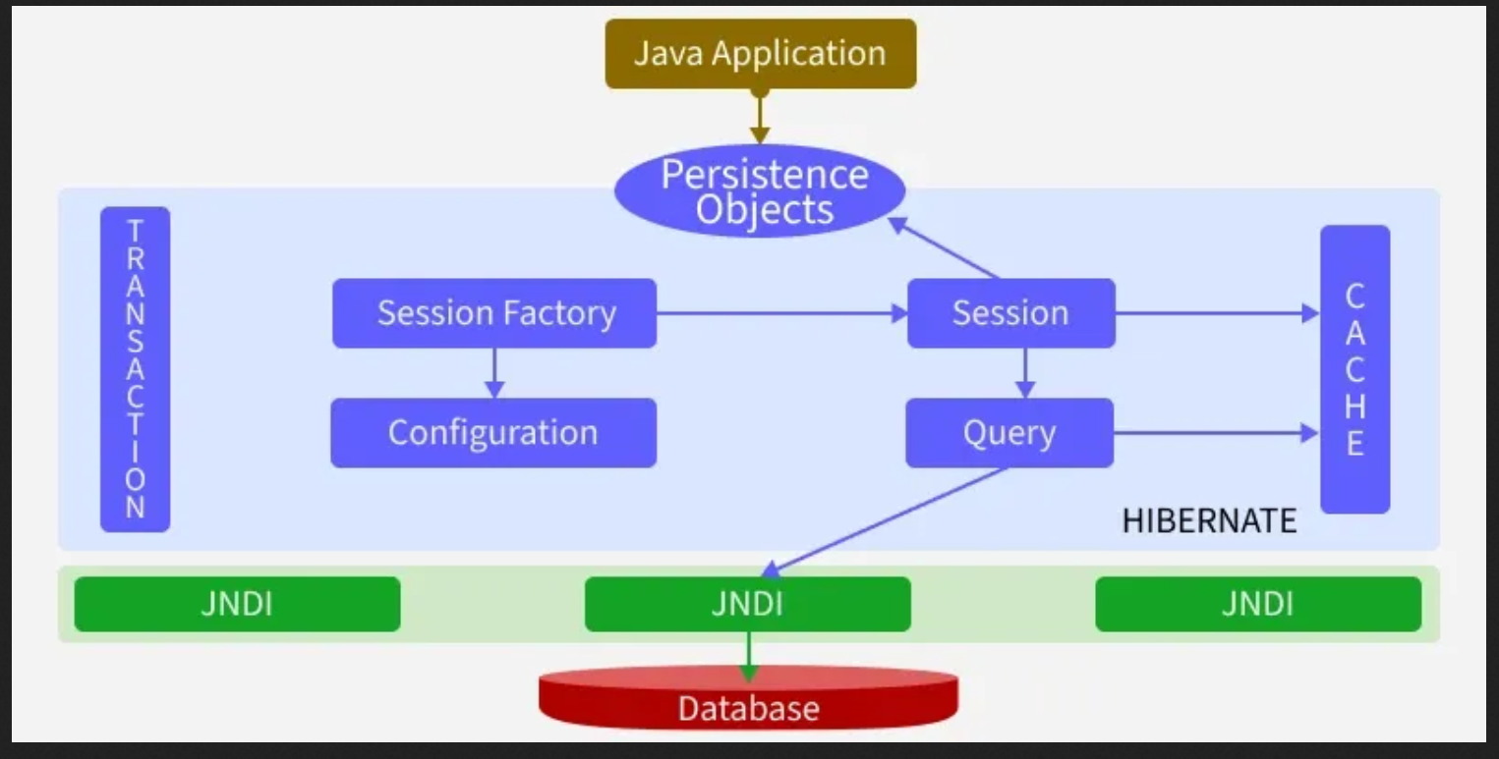
Hibernate Architecture

Slide 8
Configuration
Configuration is a class which is present in org.hibernate.cfg package. It activates Hibernate framework. It reads both configuration file and mapping files.
Example:
Configuration cfg = new Configuration();
cfg.configure(); // Reads and validates hibernate.cfg.xml
Key Points:
Activates Hibernate framework.
Reads configuration (hibernate.cfg.xml) and mapping files.
Throws an exception if the configuration is invalid.
Creates in-memory metadata representing the configuration.

Slide 9
SessionFactory
SessionFactory
The SessionFactory interface creates Session objects and maintains a second-level cache. It is heavyweight and thread-safe, so usually one per application.
SessionFactory factory = cfg.buildSessionFactory();
Key Points:
Factory for Session objects.
Thread-safe and heavy-weight.
One per database is sufficient.

Slide 10
Session
The Session interface interacts with the database and provides CRUD operations. It maintains a first-level cache (session-level).
Session session = factory.openSession();

Slide 11
Transaction
The Transaction interface handles atomic database operations, ensuring data integrity through commit or rollback.
Transaction tx = session.beginTransaction();
tx.commit(); // or tx.rollback();

Slide 12
Query
The Query interface executes HQL, Criteria API or native SQL queries to fetch or manipulate data.
Query<Student> query = session.createQuery("from Student");
List<Student> students = query.list();

Slide 13
Persistent Classes (Entities)
Java classes annotated with @Entity represent database tables. Each object maps to a row.
@Entity
class Student {
@Id
private Long id;
private String name;
}
Key Points:
Represents database tables.
Mapped via annotations or XML.
Enables object-oriented access to data.

Slide 14
Mapping
Defines the relationship between Java classes and database tables. Can be done via annotations or XML files.
@Entity
@Table(name="student")
class Department { ... }
Key Points:
Maps classes to tables and fields to columns.
Supports relationships: One-to-One, One-to-Many, Many-to-One, Many-to-Many.

Slide 15
JDBC Layer
Handles low-level database communication. Hibernate internally uses JDBC to execute SQL and retrieve results.
Key Points:
Connects to database using JDBC API.
Executes SQL queries generated by Hibernate.
Manages connection pooling and result fetching.

Slide 16
Hibernate Workflow
1. Application loads configuration (hibernate.cfg.xml). 2. Hibernate builds a SessionFactory. 3. Application requests a Session from SessionFactory. 4. Inside a Session:
Begin Transaction
Perform CRUD operations
Commit or Rollback transaction
5. Hibernate translates operations -> SQL-> executes via JDBC. 6. Results are returned as Java objects

Slide 17


www.paruluniversity.ac.in

